Slide 1
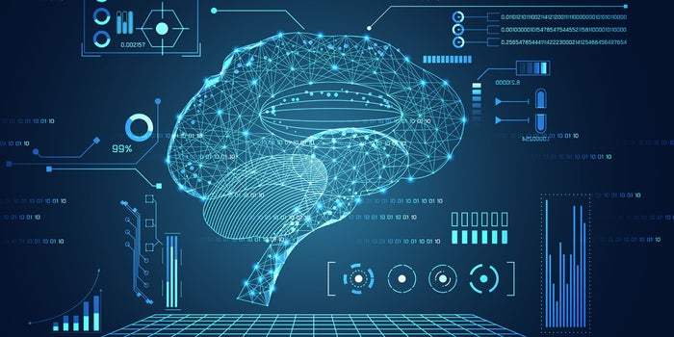

Brain-Computer Interface (BCI)
TOPIC : EMERGING TECHS
GUIDED BY : B.N.NITHYA
CREATED BY : PRATIM DUTTA
USN : 1MS18MCA24
Notes:
GEE myself PD presenting before you my seminar presentation on Emerging Technologies. Under emerging technologies the topic that i have chosen is BCI under the guidance of Nithya Ma'am.

Slide 2
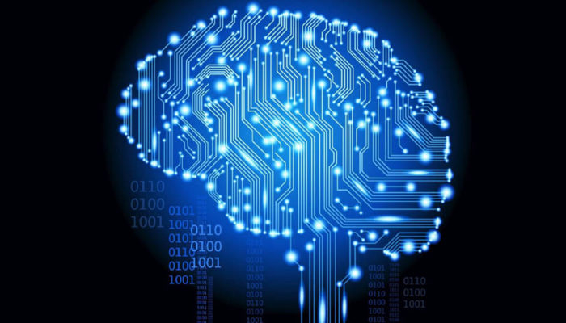
OVERVIEW
INTRODUCTION
WHAT IS BRAIN-COMPUTER INTERFACE(BCI) ?
HISTORY
GOALS & POTENTIAL
BCI WORKING
COMPONENTS
BCI TYPES
ADVANTAGES & DISADVANTAGES
BCI DEVICE EXAMPLES
FUTURE APPLICATIONS
CONCLUSION
REFERENCE

Slide 3
Introduction
A Brain-Computer Interface (BCI) is a technology which allows a human to control a computer, peripheral, or other electronic device with thoughts.
It does so by using electrodes to detect electric signals in the brain which are sent to a computer.
The computer then translates these electric signals into data which is used to control a computer or a device linked to a computer.
Notes:
I'll come to the processing part on the later slides but before that let us know what is BCI

Slide 4
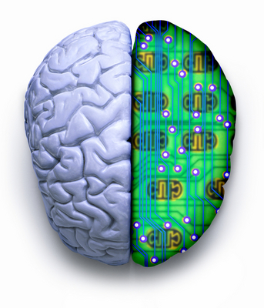
What is Brain-Computer Interface (BCI)?
Brain-Computer Interfaces (BCI) is a collaboration between a brain and a device that enables signals from the brain to do some external activity, such as control of a device
(E.g. Prosthetic Limb, Bionic Eye, etc.).
Acquires brain signals, analyze them, and translates them into commands that are transferred to output devices that carry out desired actions.
Notes:
In short it enables brain signal to control an External Device
So, how it does is, it acquires

Slide 5
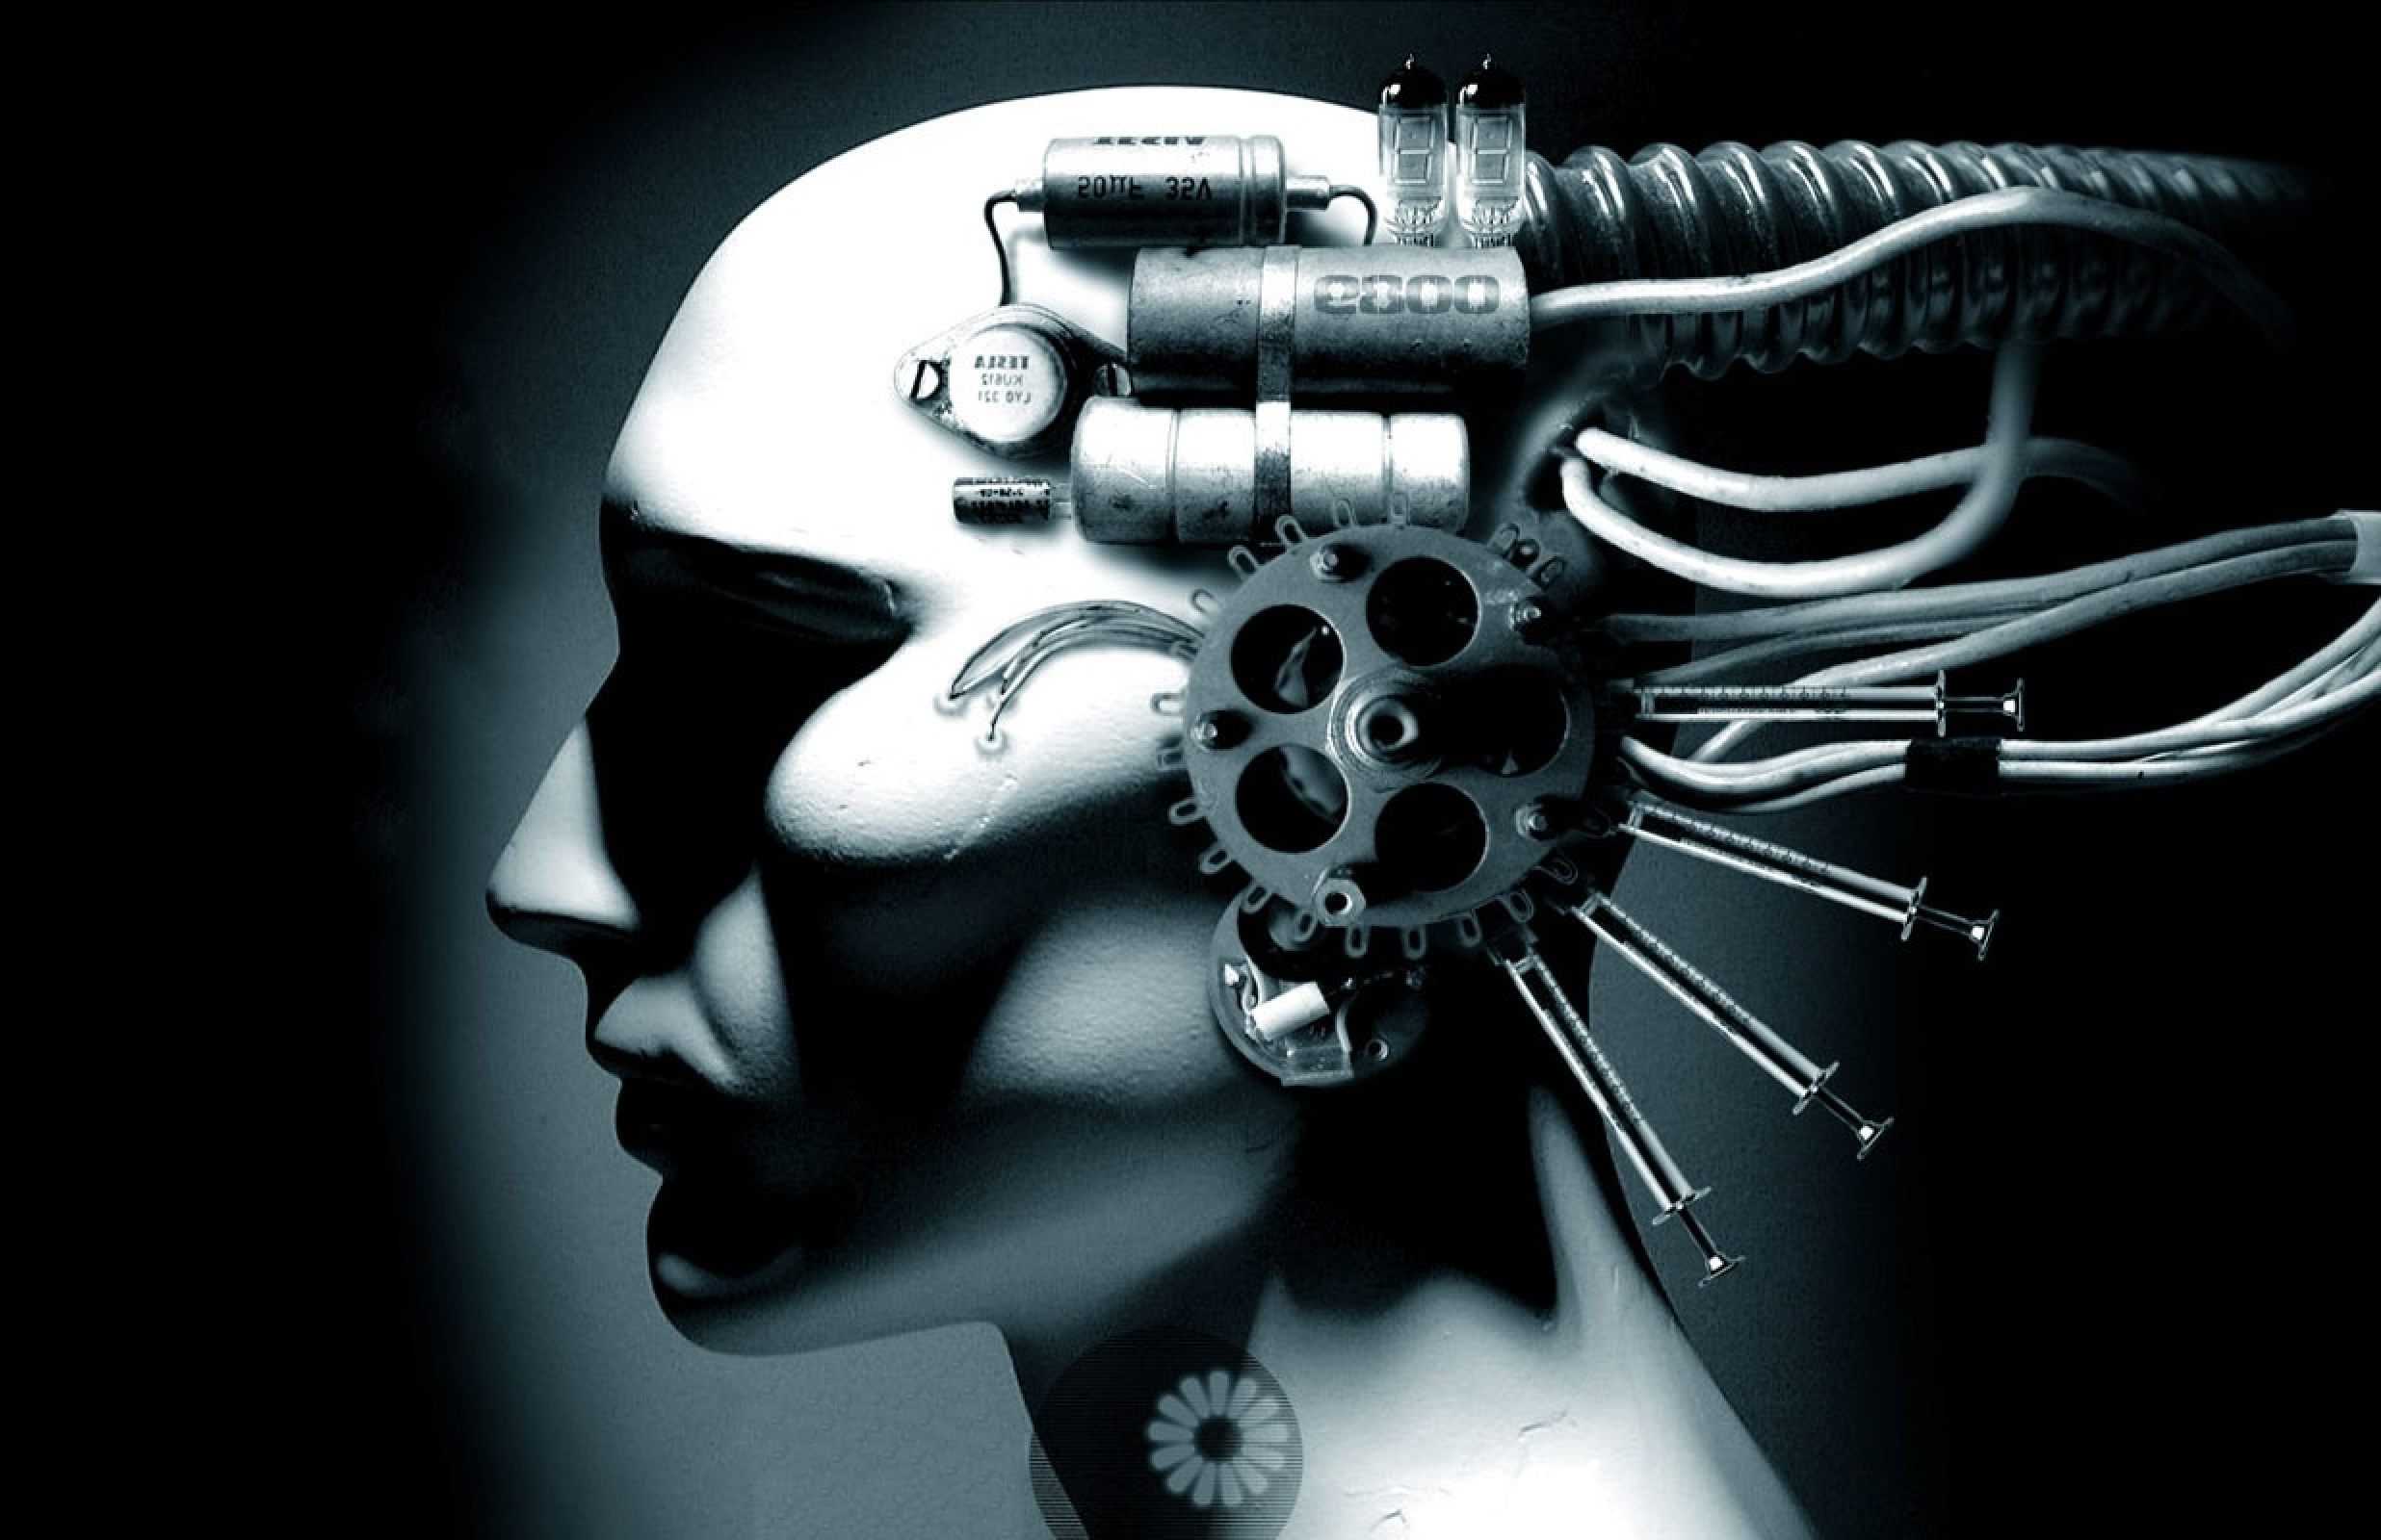
Brain Computer Interface (BCI)
A Brain-Computer Interface (BCI) is sometimes called as
Neural-Control Interface (NCI),
Mind-Machine Interface (MMI),
Direct-Neural Interface (DNI), or
Brain-Machine Interface (BMI).

Slide 6

History : When was the Bci invented?
The year 1998 marked a significant development in the field of brain mapping when researcher Philip Kennedy implanted the first brain computer interface object into a human being.
Notes:
And till today research is going on

Slide 7
Goals & POTENTIAL
The main goal of BCI is to replace or restore useful function to people who are disabled by neuromuscular disorders such as, cerebral palsy, stroke, or spinal cord injury.
BCI technology may allow individuals who are unable to speak or use their limbs, to once again communicate or operate assistive devices for walking and manipulating objects, just with thoughts from the brain.
Notes:
handicapped people will be able to speak or use prospective/artificial legs to walk or do stuffs just with thoughts from the brain

Slide 8

BCI Working

Slide 9
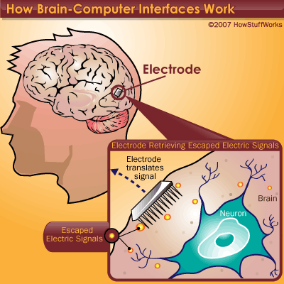
How Brain-Computer Interface(BCI) works ?
In principle, any type of brain signal could be used to control a BCI system.
The most commonly studied signals are electrical signals from brain activity measured from electrodes(silicon chips) on the scalp, on the cortical surface, or in the cortex.
Notes:
As we know, our brain passes electrical signal from one neuron to another and during this process some electrical signal gets escaped. The escaped signals are retrieved/captured with the help of electrodes and then further processed

Slide 10
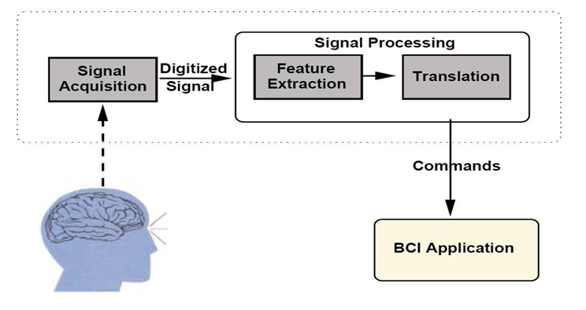
Components of a BCI System
1) Signal Acquisition,
2) Feature Extraction,
3) Feature Translation, and
4) Device Output
These 4 components are controlled by an operating protocol that defines the onset and timing of operation

Slide 11
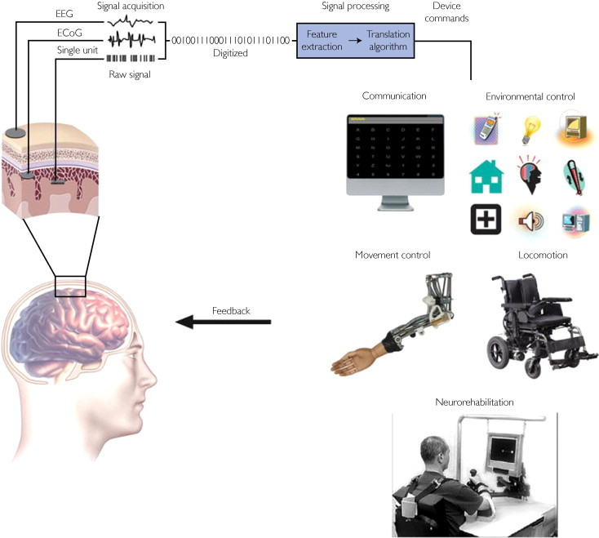
BCI system showing signal detection, processing and command outputs.
Notes:
BCI=Brain-Computer Interface, ECoG=Electrocorticography, EEG=Electroencephalography

Slide 12
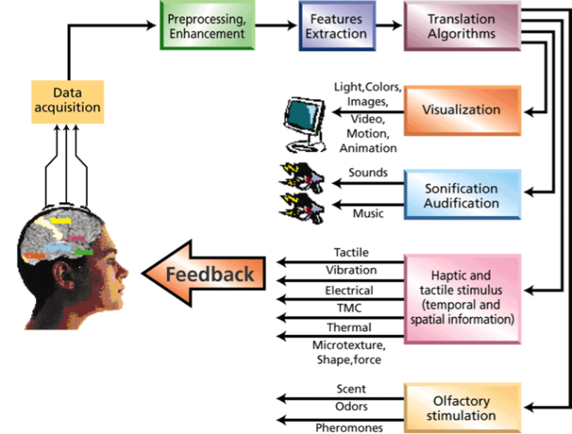
Types of operations done after signals translated
Notes:
Haptic - sense of touch
Tactile - feeling of touch Eg - tickling
Olfactory - relating to smell

Slide 13
BCI Types
Invasive
Partial Invasive
Non Invasive
EEG
Neurosurgery
ECoG
MEG
fMRI
Notes:
EcoG – Electrocorticography
EEG - Electroencephalography
MEG - Magnetoencephalography
fMRI - functional Magnetic Resonance Imaging

Slide 14
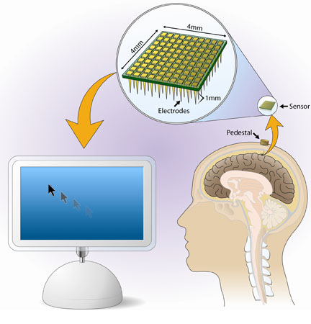
Invasive BCIs
Electrodes are implanted directly into the grey matter of the brain by neurosurgery.
As they rest in the grey matter, it produces the highest quality of neuron signals among other BCI types.
But are prone to scar tissue build-up, causing the signal to become weaker or even lost as the body reacts to a foreign object in the brain.
BrainGate Neural Interface System
Notes:
As we know our body has a tendency to repair itself by removing foreign objects

Slide 15
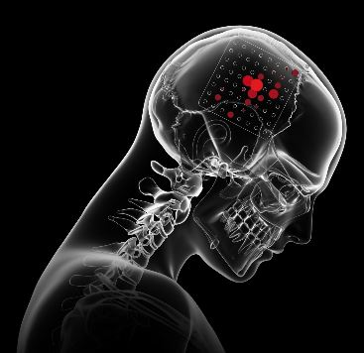
Partially Invasive BCIs
Electrode Grids are implanted inside the skull but outside the grey matter by surgical incision.
It records the neuron signals of the brain from inside the skull, but from the surface of the brain.
Electrocorticography(ECoG) is the example of partially invasive BCI.

Slide 16
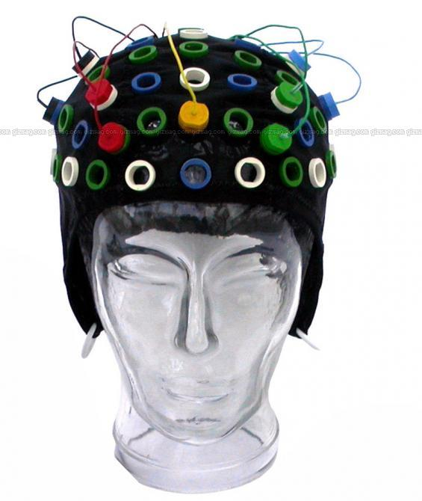
Non-Invasive BCIs
It is the most useful neuron signal imaging method in which electrodes are applied on the outside of the skull i.e. on the scalp.
It records the activity of the brain externally.
Techniques:-
Electroencephalography(EEG)
Magnetoencephalography(MEG)
functional Magnetic Resonance Imaging(fMRI)

Slide 17
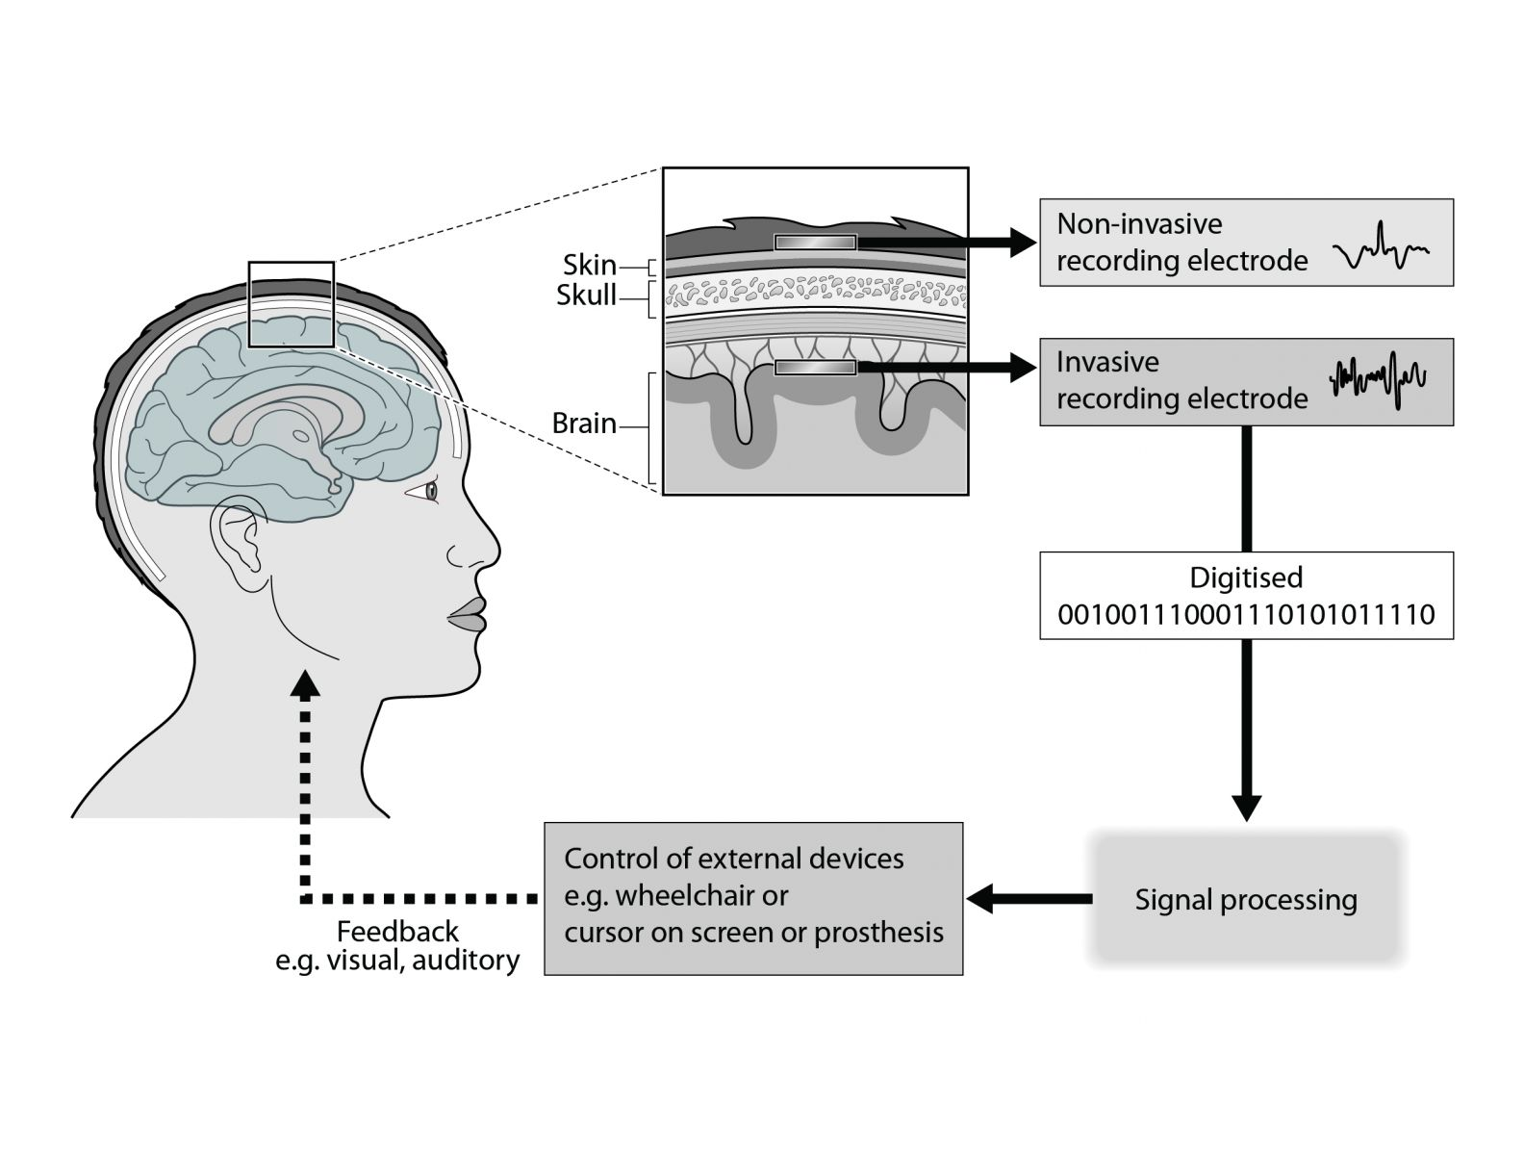

Slide 18
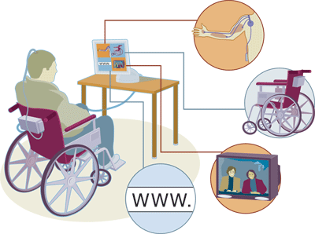
Advantages of BCI
This technology can:
Allow paralyzed people to control prosthetic limbs with their mind.
Transmit visual images to the mind of a blind person, allowing them to see.
Transmit auditory data to the mind of a deaf person, allowing them to hear.
Allow gamers to control video games with their minds.
Allow a mute person to have their thoughts displayed and spoken by a computer.

Slide 19
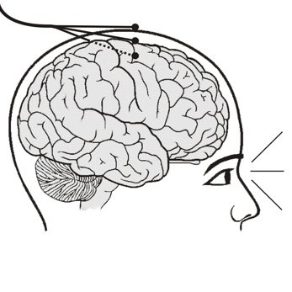
Disadvantages of BCI
Research is still in the beginning stages.
This technology is still in unrefined state(raw state).
Ethical issues may prevent its development.
Electrodes outside of the skull can detect very few electric signals from the brain.
Electrodes placed inside the skull may create scar tissue in the brain.
Notes:
Ethical issues –
personality changes,
have to think in a different way,
feel artificial
As we know our body has a tendency to repair itself

Slide 20
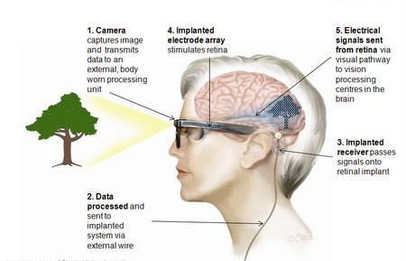
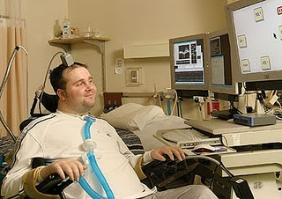
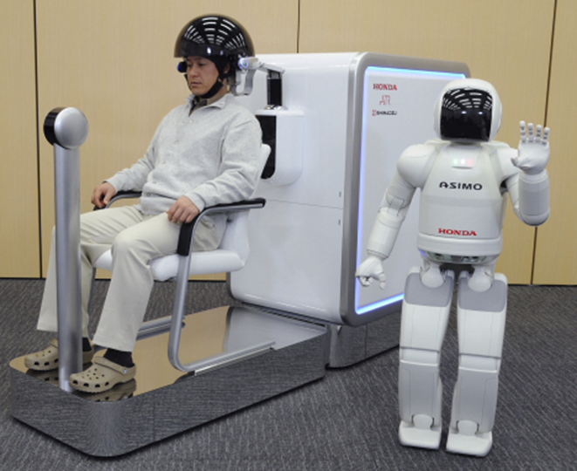
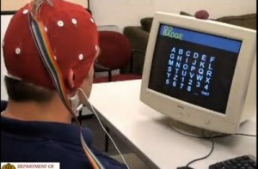
Brain Gate
Some Real Life Examples of
BCI
Australian Bionic Eye
Honda Asimo Control
BCI2000

Slide 21
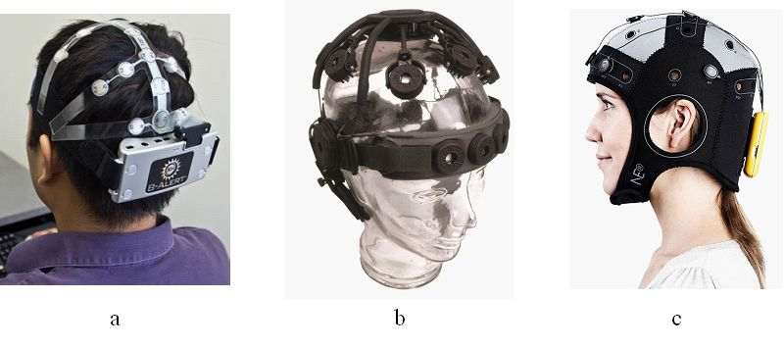
Wireless BCI systems

Slide 22
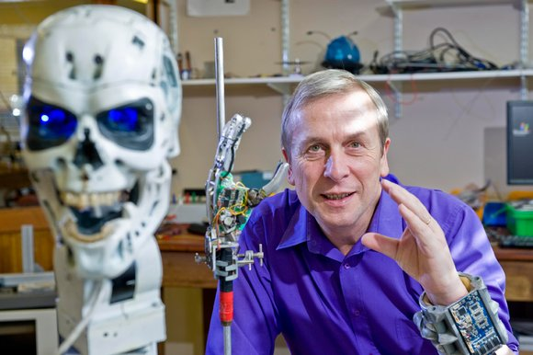
Kevin Warwick – The First Human Cyborg

Slide 23
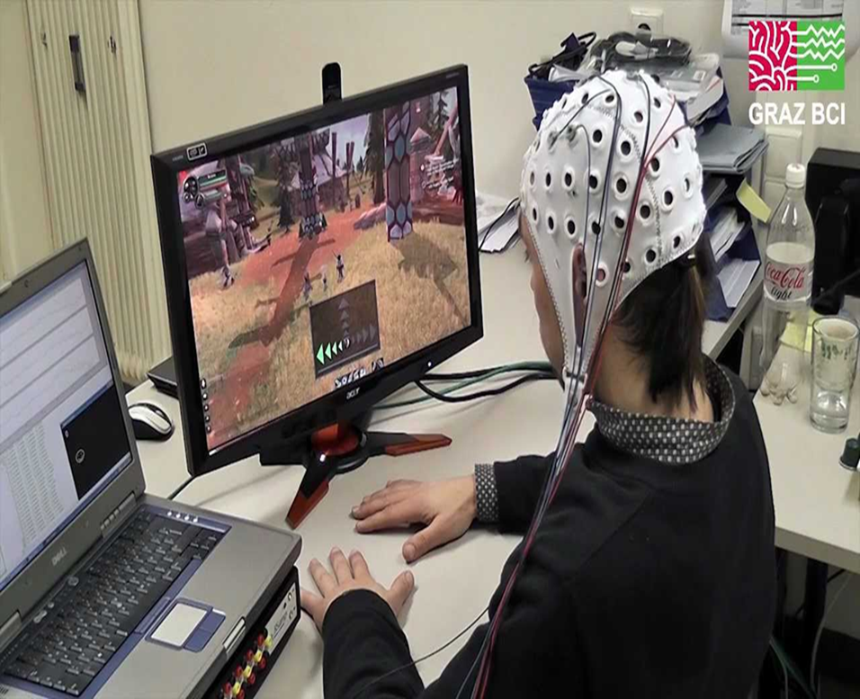
BCI Gaming

Slide 24
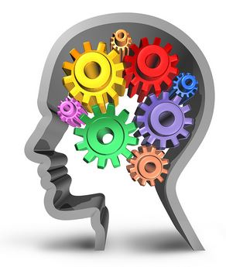
Future Applications of BCIs
Provide additional channel of control in computer games.
Provide disabled people with communication, environment control, and movement restoration.
Provide control of devices such as wheelchairs, vehicles, or assistance robots for people with disabilities.
Control robots that function in dangerous or inhospitable situations (e.g., underwater or in extreme heat or cold).
Develop intelligent relaxation devices and passive devices for monitoring behaviors such as long-term drug effects, evaluating psychological state, therapeutic methods, etc.
Monitor stages of sleep, Bionics/Cybernetics, Memory Upload/Download, Dream Capture etc.
Facebook Brain-Computer Interface for typing and skin-hearing.
Neuralink - An Initiative by Elon Musk(Neuralink : How the Human Brain Will Download Directly from a Computer).

Slide 25
Conclusion
As the BCI technology further advances, brain tissue may one day give way to implanting of silicon chips thereby creating a completely computerized simulation of the human brain that can be augmented at will.
Futurists predict that from there, superhuman artificial intelligence won't be far behind…
Notes:
As i said about creation of scar tissues so one day that problem will be solved.

Slide 26
REFERENCES
www.ncbi.nlm.nih.gov/pmc/articles/PMC3497935/
en.wikipedia.org/wiki/Brain%E2%80%93computer_interface
www.seminarlinks.blogspot.com
https://interestingengineering.com/neuralink-how-the-human-brain-will-download-directly-from-a-computer

Slide 27
Thank You…!!

Slide 28
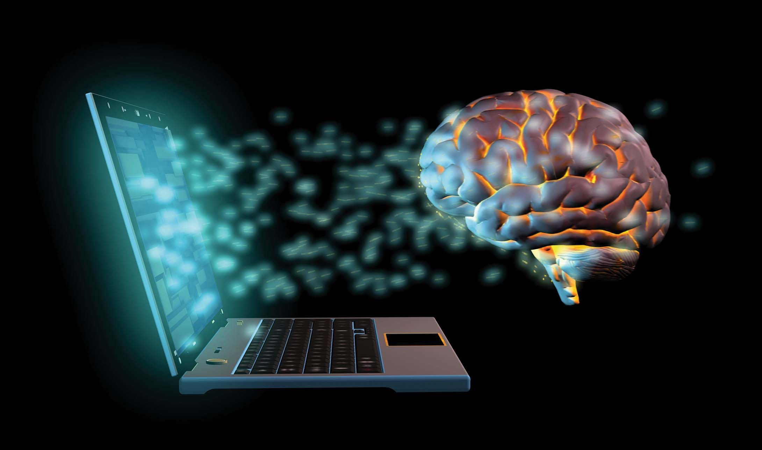
Any Questions…???

